Slide 1
Building high-performance text classifiers on a limited labeling budget
Ali-Kazim Zaidi
Robert Horton
Mario Inchiosa

Slide 2
Session Goals
Learn how to use transfer learning from complex language models trained on large datasets (often by someone else) to generate features that can be used with simple models capable of learning from small datasets
Understand how active learning can help you select examples from a pool of unlabeled cases that will be most effective for training a model
Discover how to use the hyperparameter tuning process on a scalable cloud-based architecture

Slide 3
The revolution will not be supervised!
– Professor Alexei Efros

Slide 4
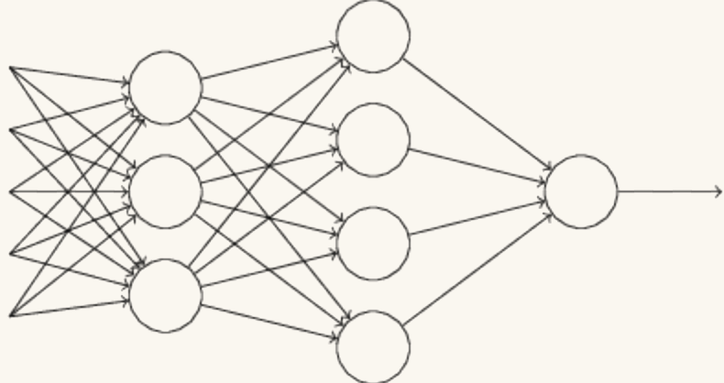
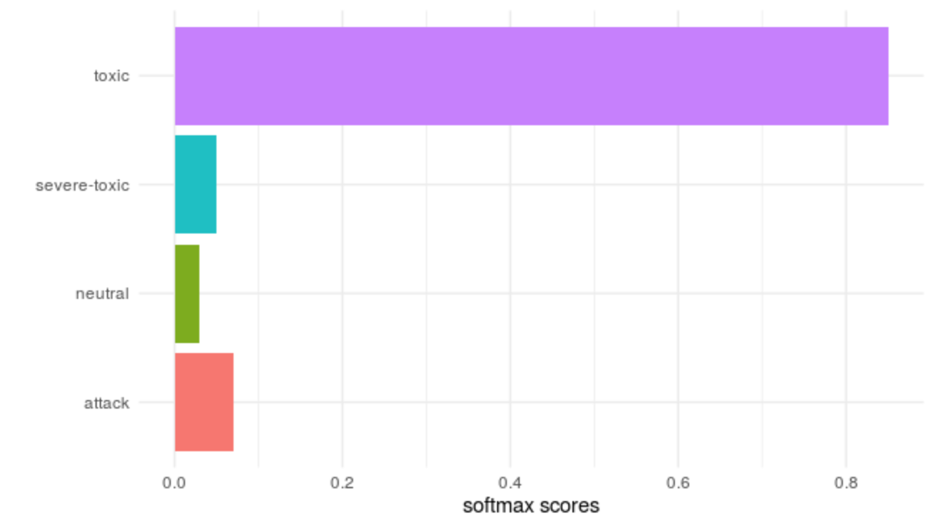
End-to-End Task Specific Learning
Last 6 years: incredible performance on single-task learning
Things to worry about:
Need lots of data per task (roughly 1000x per category)
Can easily overfit even within a domain (often need careful regularization strategies)

Slide 5
Overfitting on Tasks
performance
Training performance
Test performance
Training data
We’ve transitioned from memorizing training data to memorizing training tasks

Slide 6
Pre-trained word embeddings
Word embeddings have formed the basis of deep learning for NLP
Word embeddings (word2vec, GloVe) aim to learn semantic representations from text using co-occurrence statistics
banana
mango
dog
Inner Product
Inner Product
The dog wagged his tail
The mango fell from the tree

Slide 7
Contextual Representations
Word embeddings are learned using a context-free procedure (word aggregate statistics), but applied in context-dependent scenarios (sentences/paragraphs)
I have insufficient funds in my bank account
[0.8, 0.1, -0.3, …]
Alex skipped rocks by the river bank
Could we instead learn a contextual representation for the whole sentence/paragraph?

Slide 8
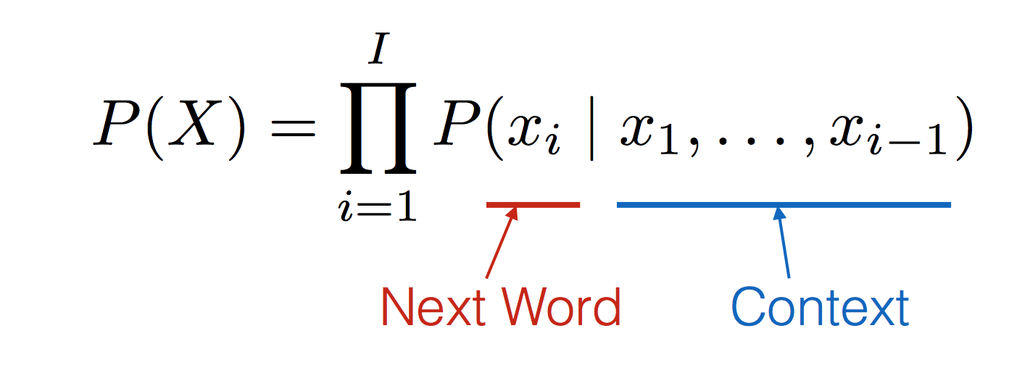
Let’s Go Deeper: Language Models
The cat sat on the mat
The mat sat on the cat
Sat cat on the mat
On mat sat the cat
Cat mat sat on the
Calculate the probability of a sentence
Can be trained without supervision / self-supervision

Slide 9
Bi-Directional Encoder Representations from Transformer
The Illustrated BERT: http://jalammar.github.io/illustrated-bert/

Slide 10
Domain-Specific LM Fine-Tuning
BERT’s optimization tasks aren’t designed for most down-stream tasks
Fine-tuning all of the weights of BERT is a time-consuming procedure
Let’s fine-tune the entire language model on the entirety of the dataset we have
Then let’s adjust the language model for the transfer learning task
Potential for domain-specific language models: Bio-BERT, etc.

Slide 11
Multi-Task Learning with BERT (MT-DNN/BERT)
Can we utilize a more structured set of tasks for pre-training?
Prevent catastrophic forgetting by continual training
Multiple tasks can act as a regularizer, shrinking weights towards representations that generalize across multiple tasks
Can continue to utilize more data (no longer task-specific)

Slide 12
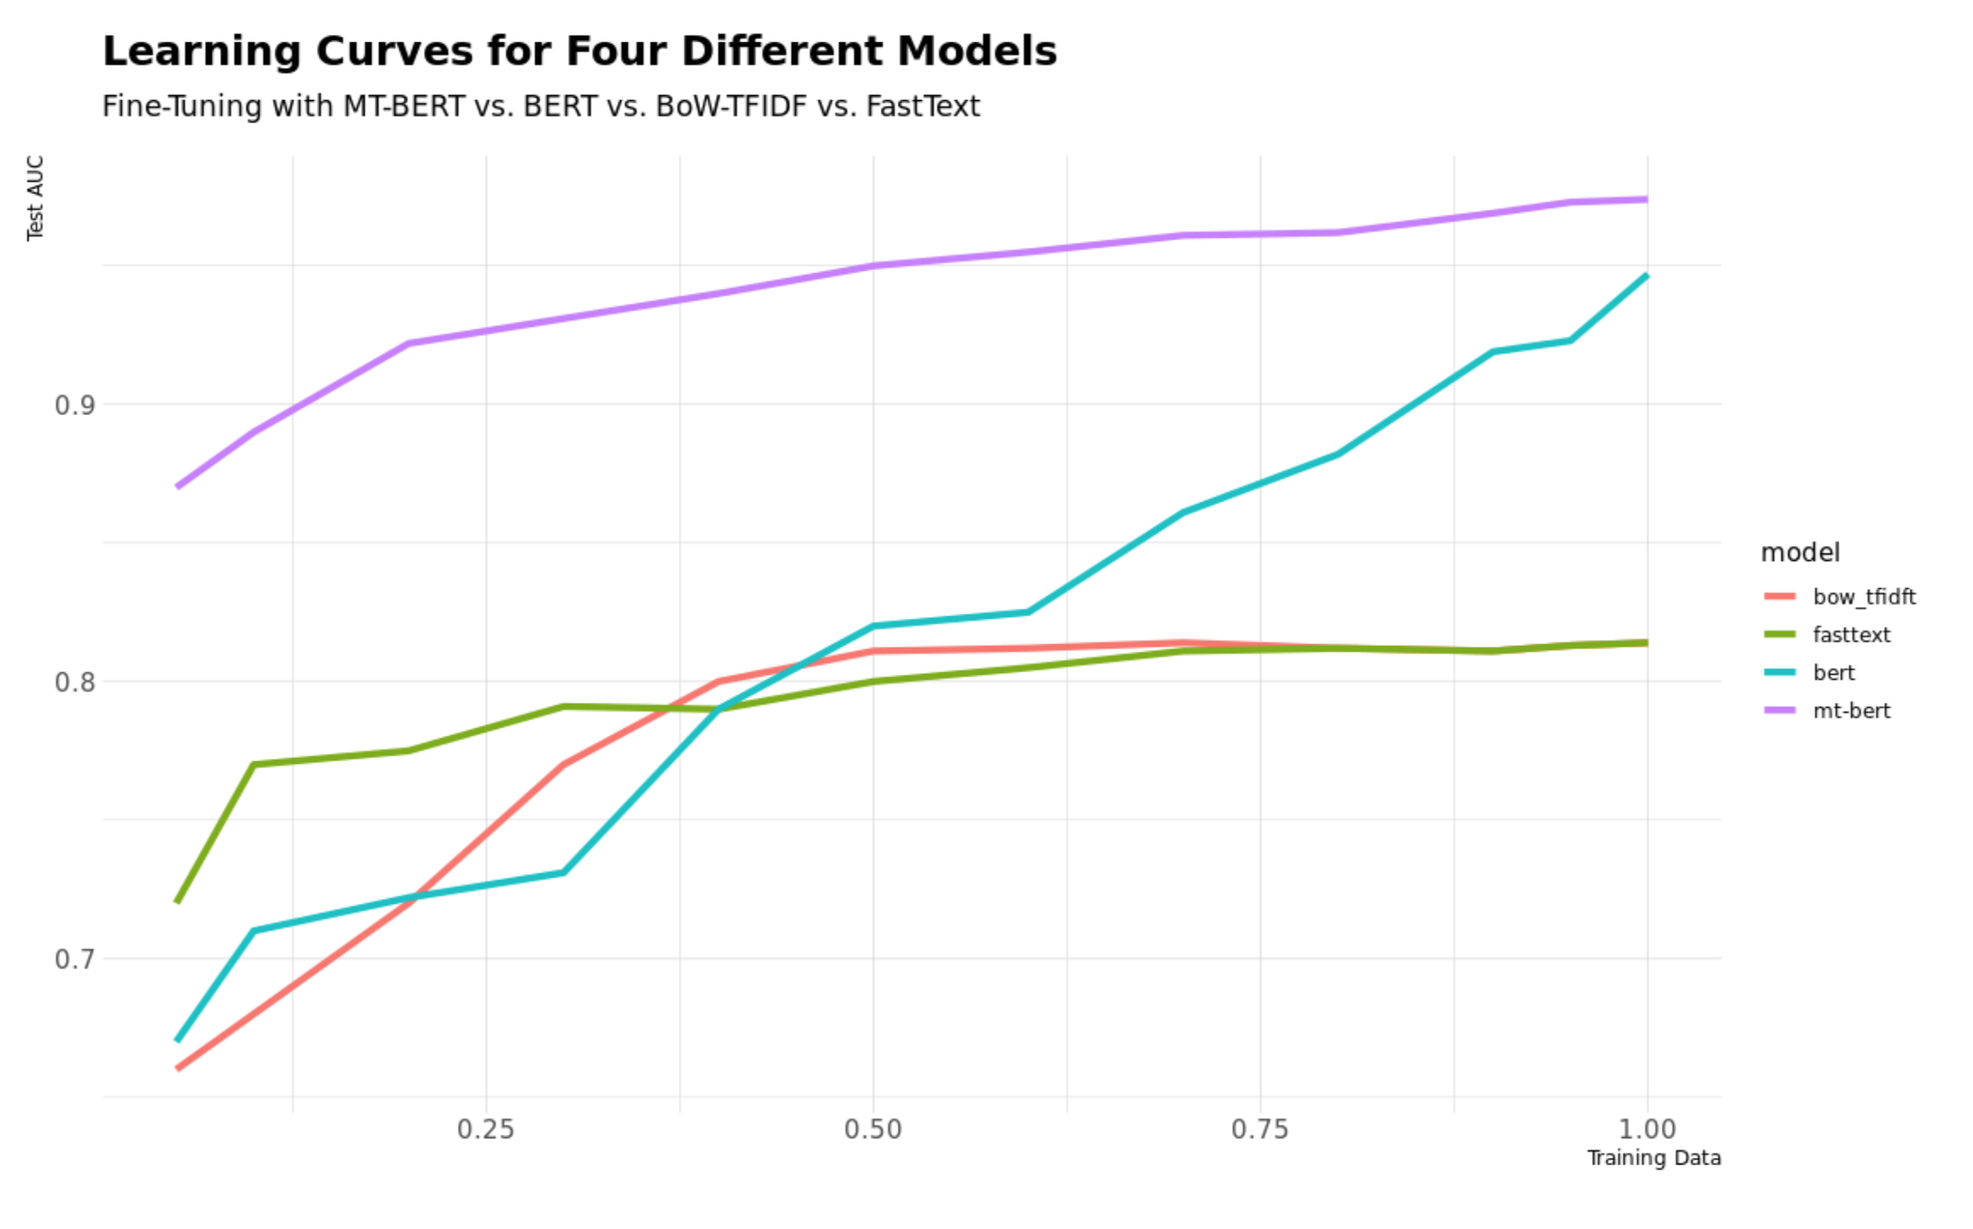
Multi-Task BERT Results
See active-learning-workshop: text_featurization/lm_finetune/1A.ipynb

Slide 13
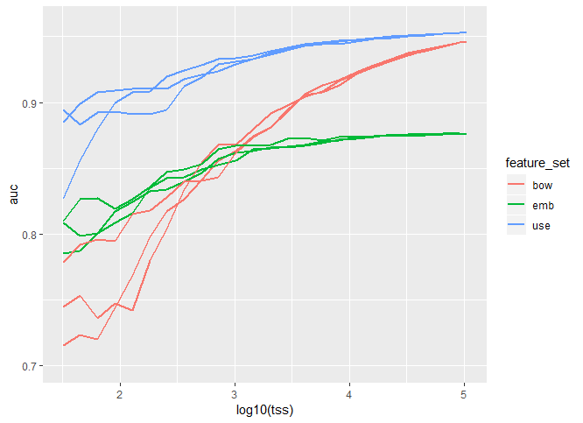
Learning curves comparing models built with different feature sets
Simpler features may work better with small training sets, even though more complex features work better with more training examples.
Better featurization can give you the best of both worlds.
use: universal sentence encoder
emb: average word embedding
bow: “bag of words” (n-gram frequency)

Slide 14
Wikipedia detox dataset
Active learning from text data.
Binary classifier: is this comment a personal attack?
Featurization from pre-trained language model (USE).
arXiv:1610.08914v2

Slide 15
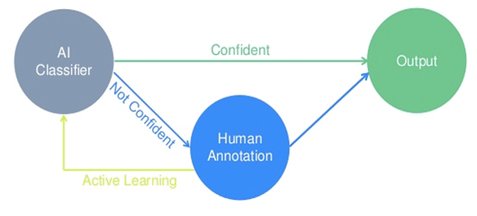
Active Learning
Data is often easier to come by than expert labels
Active Learning intersperses labelling of samples with incremental re-training. The currently trained model is used to select new samples to label. There are variety of approaches for selecting samples, depending on the data and model.
https://www.crowdflower.com

Slide 16
Algorithm Sketch
Given an initial model, M and unlabeled set of cases U:
Using the current model M make class c likelihood predictions, P(c | U) = M(U).
Select a set to label L (possibly one) from U, based on M(U)
Update M with the expanded training set T’ <- T + L
Repeat until model improvement / labeling cost < threshold
Active Learning methods differ by the way they use the model to search over the unlabeled cases U.

Slide 17
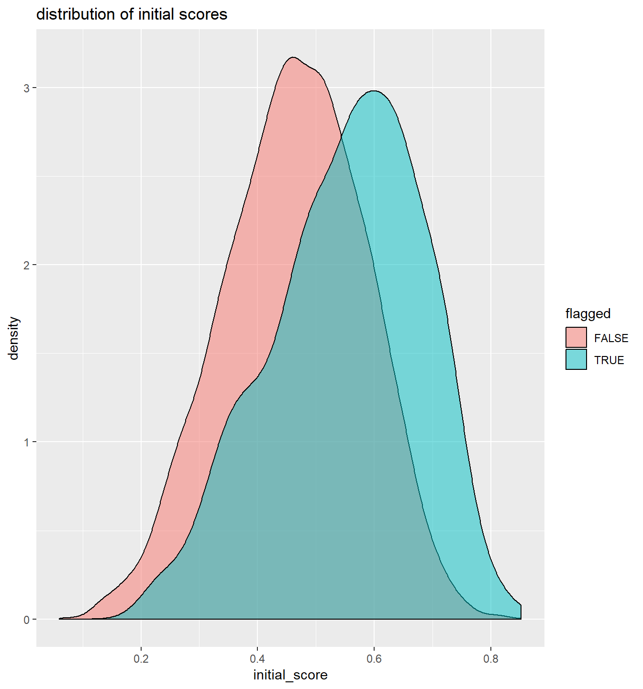
Uncertainty Sampling
select additional cases where the current model is least certain

Slide 18
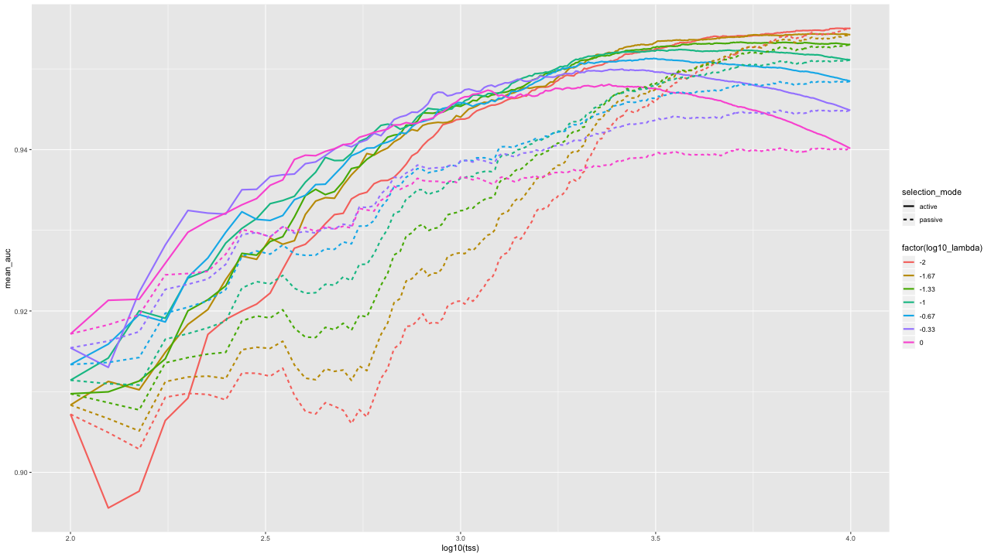
Active learning
regularization

Slide 19
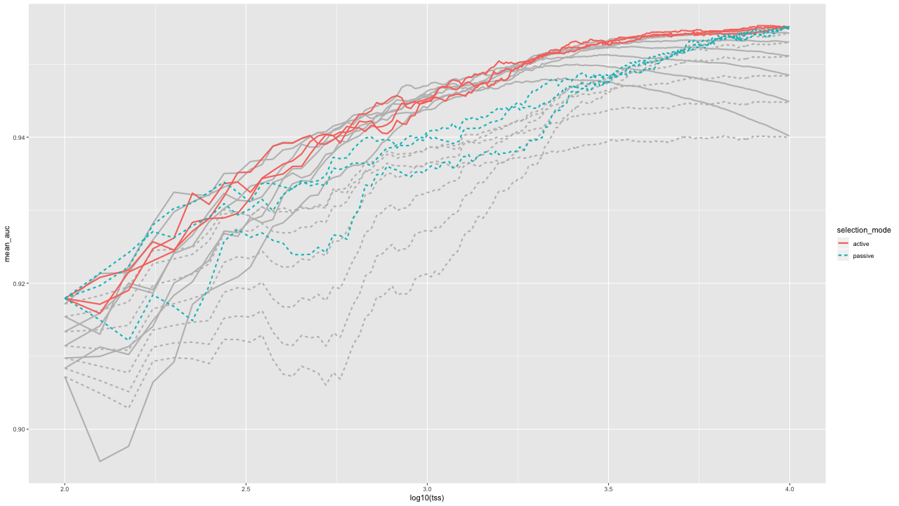
Tuning at each step

Slide 20
But I don’t want to pay to label a validation set! Why can’t I use cross-validation?

Slide 21
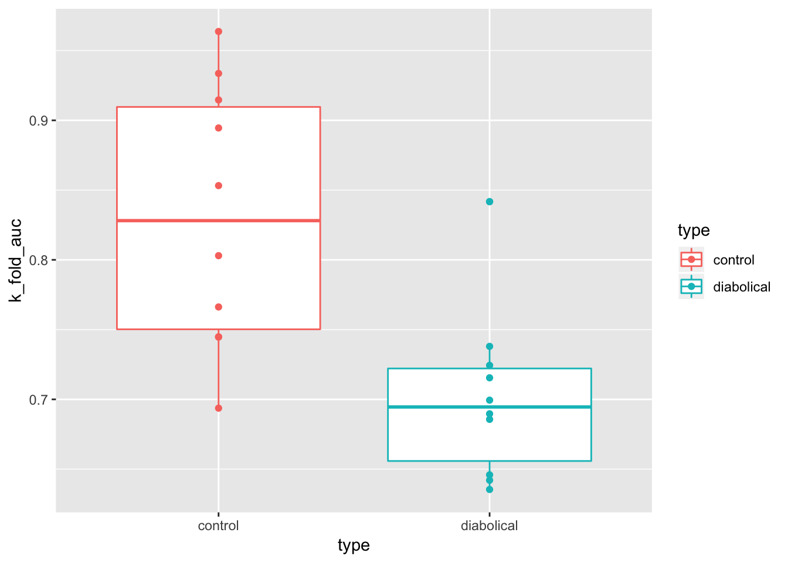

Slide 22
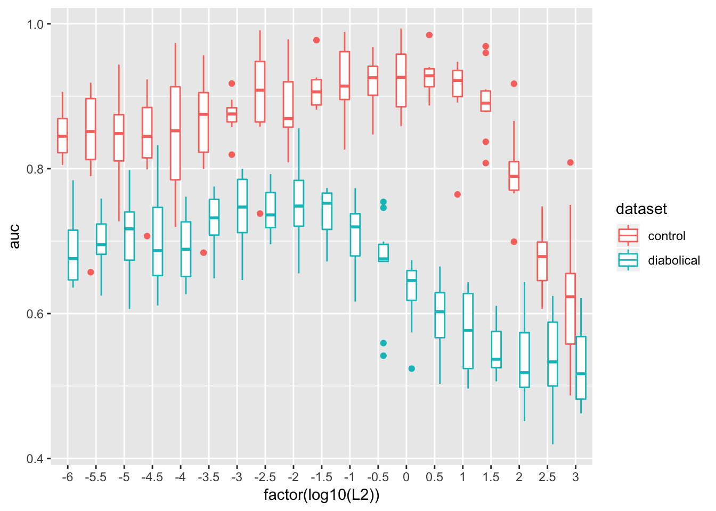

Slide 23
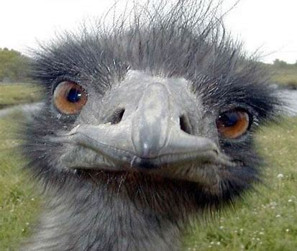
How Uncertainty Sampling Fails

Slide 24
Hyperparameter Tuning
Most ML algorithms have multiple “hyperparameters”
Maximum depth of a Decision Tree
Number of decision trees in a Random Forest
Learning rate for training a Deep Learning model
Regularization parameters for Elastic Net Regression
Tuning hyperparameters is important for maximizing model performance

Slide 25
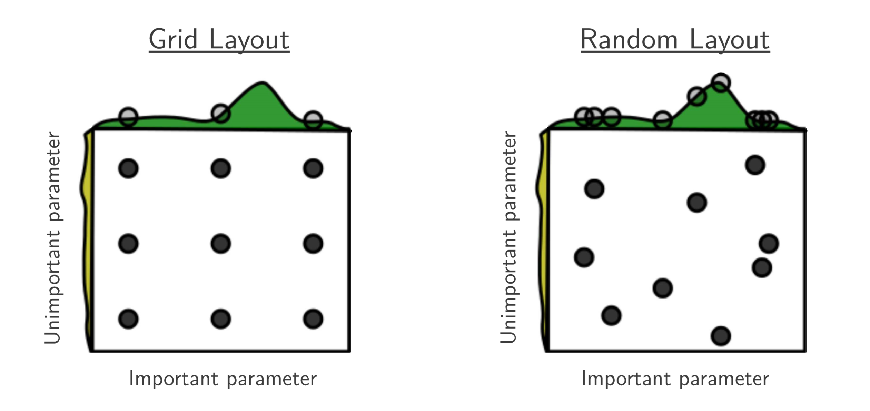
Hyperparameter Tuning Methods
Grid search vs. Random search
Bergstra and Bengio, Journal of Machine Learning Research 13 (2012) 281-305.

Slide 26
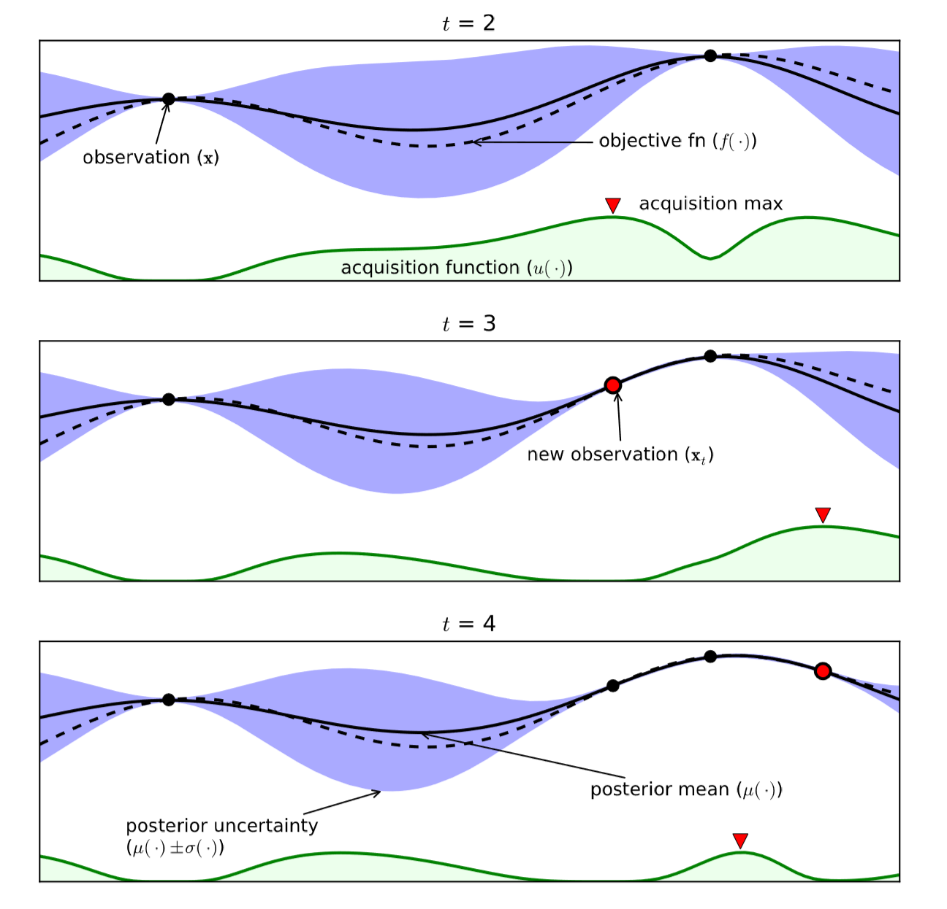
Hyperparameter Tuning Methods
Bayesian optimization
Iteratively builds a probabilistic model of the objective function
Focuses tuning trials on most promising regions
Serial loop
Brochu, Cora, and de Freitas, A Tutorial on Bayesian Optimization of Expensive Cost Functions, with Application to Active User Modeling and Hierarchical Reinforcement Learning

Slide 27
Scalable Hyperparameter Tuning
R tools for use with Apache Spark
 | Hyperparameter tuning | Random search | Non-random train and validation sets | Fits models in parallel (“task-parallel”)
Apache SparkR
RStudio sparklyr | ✔ |  |  | ✔
H2O RSparkling | ✔ | ✔ | ✔
SparkR + our demo notebook | ✔ | ✔ | ✔ | ✔
Python tools for use with Apache Spark
Apache PySpark pyspark.ml.tuning
MMLSpark
Spark-sklearn
H2O PySparkling – also supports Automated Machine Learning
Azure Machine Learning Service – also supports Automated Machine Learning

Slide 28
Microsoft Spark Platforms
Azure HDInsight
Cloud-based
Azure Databricks
Cloud-based
SQL Server 2019 Big Data Cluster (preview)
Kubernetes-based: on-premises or in a cloud-based Kubernetes service such as Azure Kubernetes Service

Slide 29
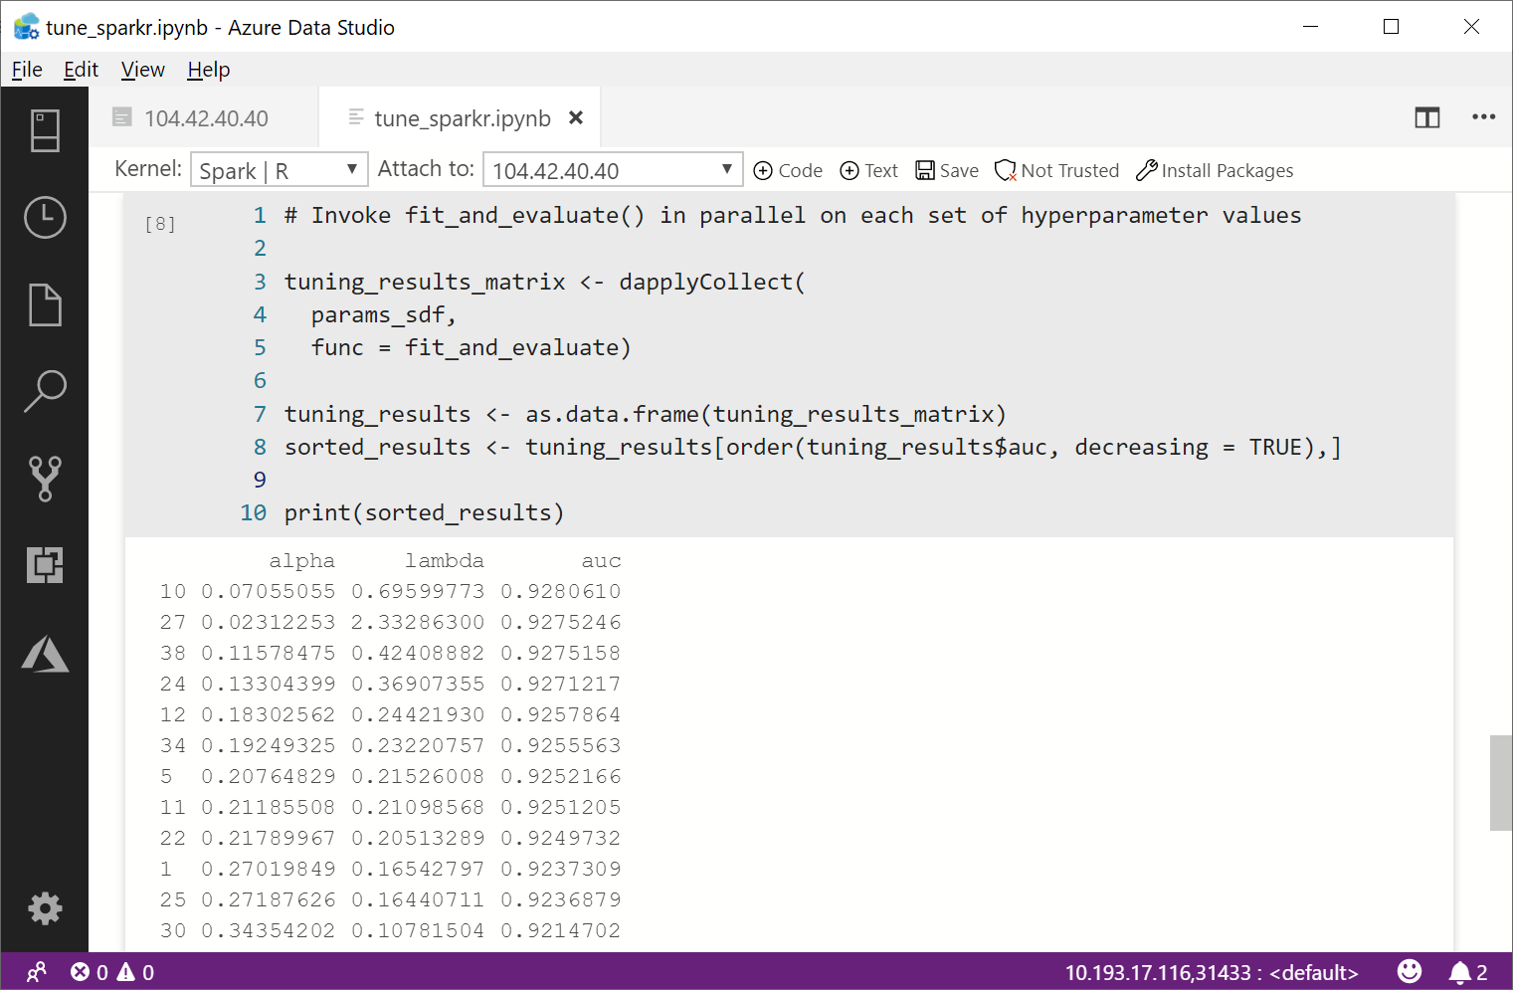
Hyperparameter Tuning with SparkR
https://aka.ms/tune_sparkr

Slide 30
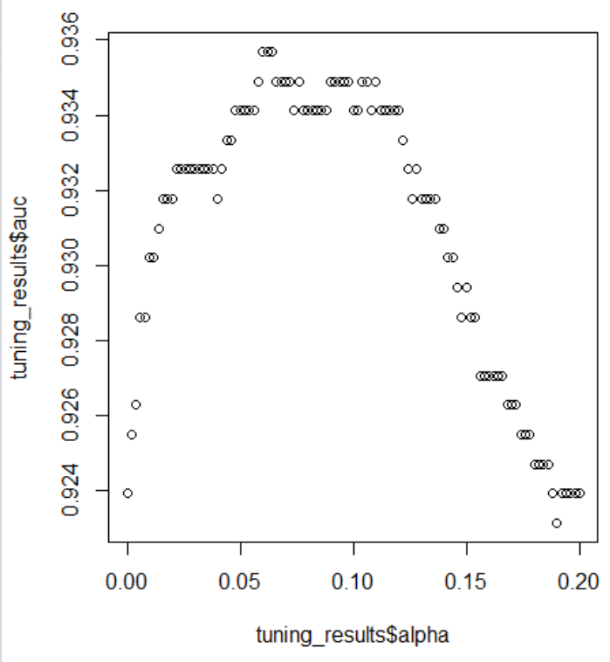
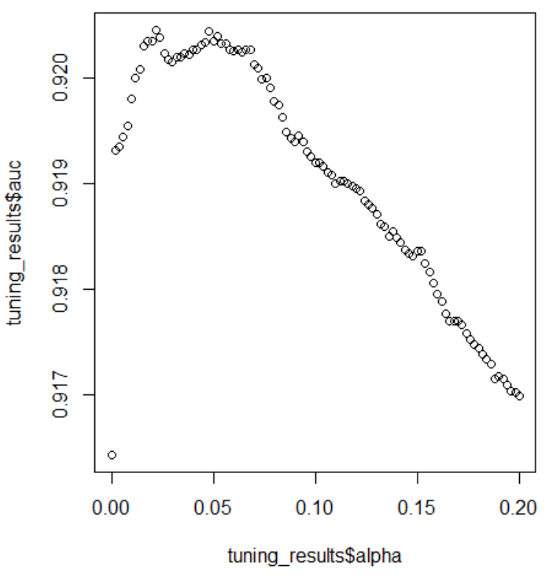
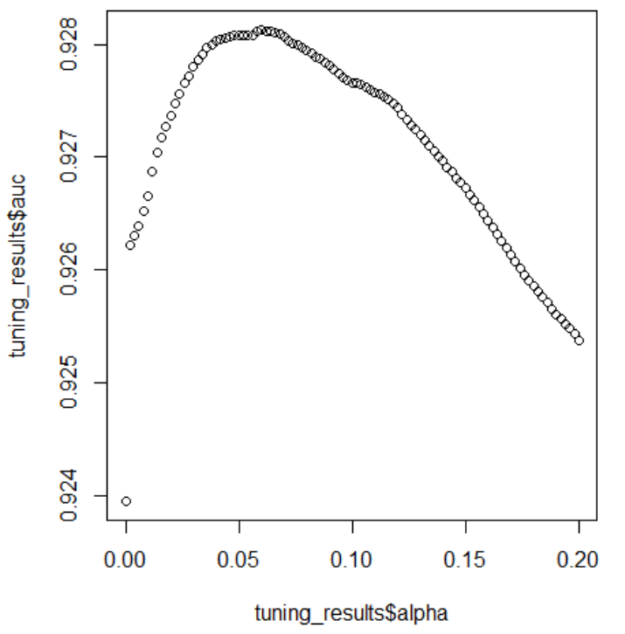
Effect of Validation Set Size
N = 100
N = 1,000
N = 10,000

Slide 31
Summary and Resources
Transfer learning – easily featurize your data using intensively trained deep-learning-based Language Models
Active learning – efficiently spend your labeling budget
Hyperparameter Tuning – get the most out of your ML algo
Active learning workshop repo: https://github.com/Azure/active-learning-workshop

Slide 32
Rate today ’s session
Session page on conference website
O’Reilly Events App

